Slide 1
Water Quality Predictors for Key Indiana Reservoirs
Indiana Watershed Leadership Academy
Final Project Presentation
Garrison Inn
Ft. Harrison State Park
Indianapolis, IN
20 May 2015
By
Morgan Bennett
Carol Newhouse
Kelsey Owens

Slide 2
Motivation for this Project
Climate changes are affecting water supplies across the nation and globally
Growth and well-being of society is dependent on readily available water supply
Current efforts and/or future needs to build water supply reservoir(s) in Indiana
Wondering if history had anything to teach us

Slide 3
Discovery Steps
List of Impoundments/Reservoirs in Indiana
Mapping of Impoundments and their Watersheds
Data Gathering from On- and Off-line Sources

Slide 4
First Step
List of Impoundments/Reservoirs in Indiana
  Over 600 lakes/reservoirs in state
  Easily 150+ impoundments
    21 major river impoundments
    16 large water supply impoundments
    35 local/state/federally owned
    11 other working impoundments
    75+ privately owned impoundments
  Narrowed list to most similar waterbodies

Slide 5
Basic Literature Search (online)
Removed host of small water supply reservoirs and recreational impoundments
Removed few cooling water reservoirs
Ended up with 18 key reservoirs to consider

Slide 6
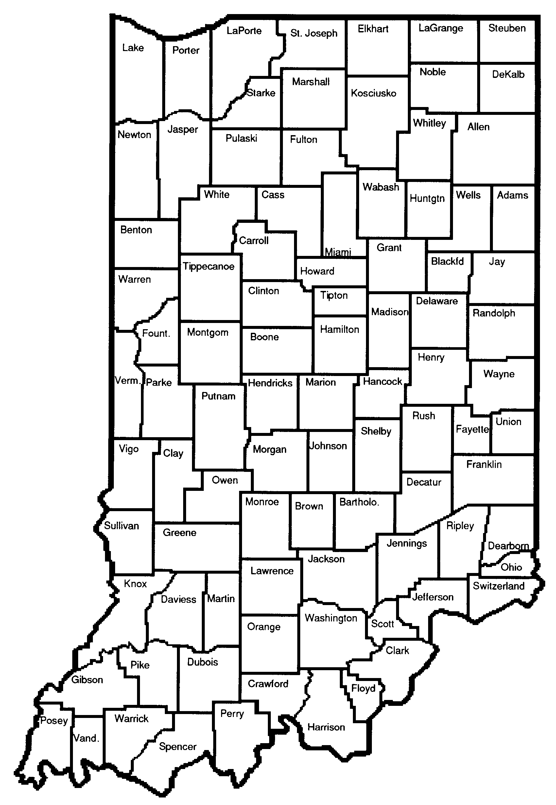
Key Reservoirs
Shafer
Freeman
Kokomo #2
Morse
Eagle Creek
Geist
Cecil M. Harden
Cagles Mill
Patoka

Slide 7
Key Reservoirs
Cedarville
J. Edward Roush
Mississinewa
Salamonie
Prairie Creek
Brookville
Lemon
Monroe
Mounds

Slide 8
Second Step
Mapping of impoundments and their watersheds
  Online tools
    Google Maps
    Indiana Maps
  Defining data layers
  Scale

Slide 9
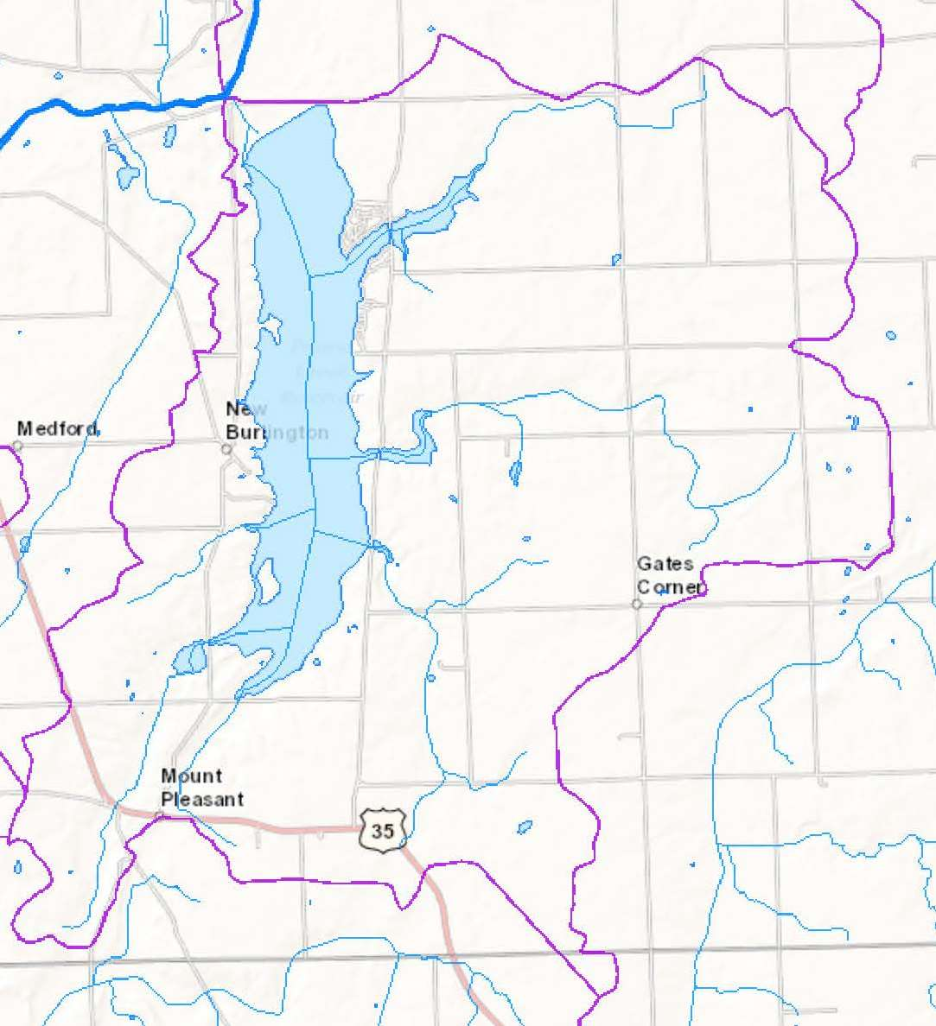
Prairie Creek
Some with rather small watersheds (Group 1)
Size relation = 11.3%
1 acre of water drains <9 acres of land
Best example
1:6400

Slide 10
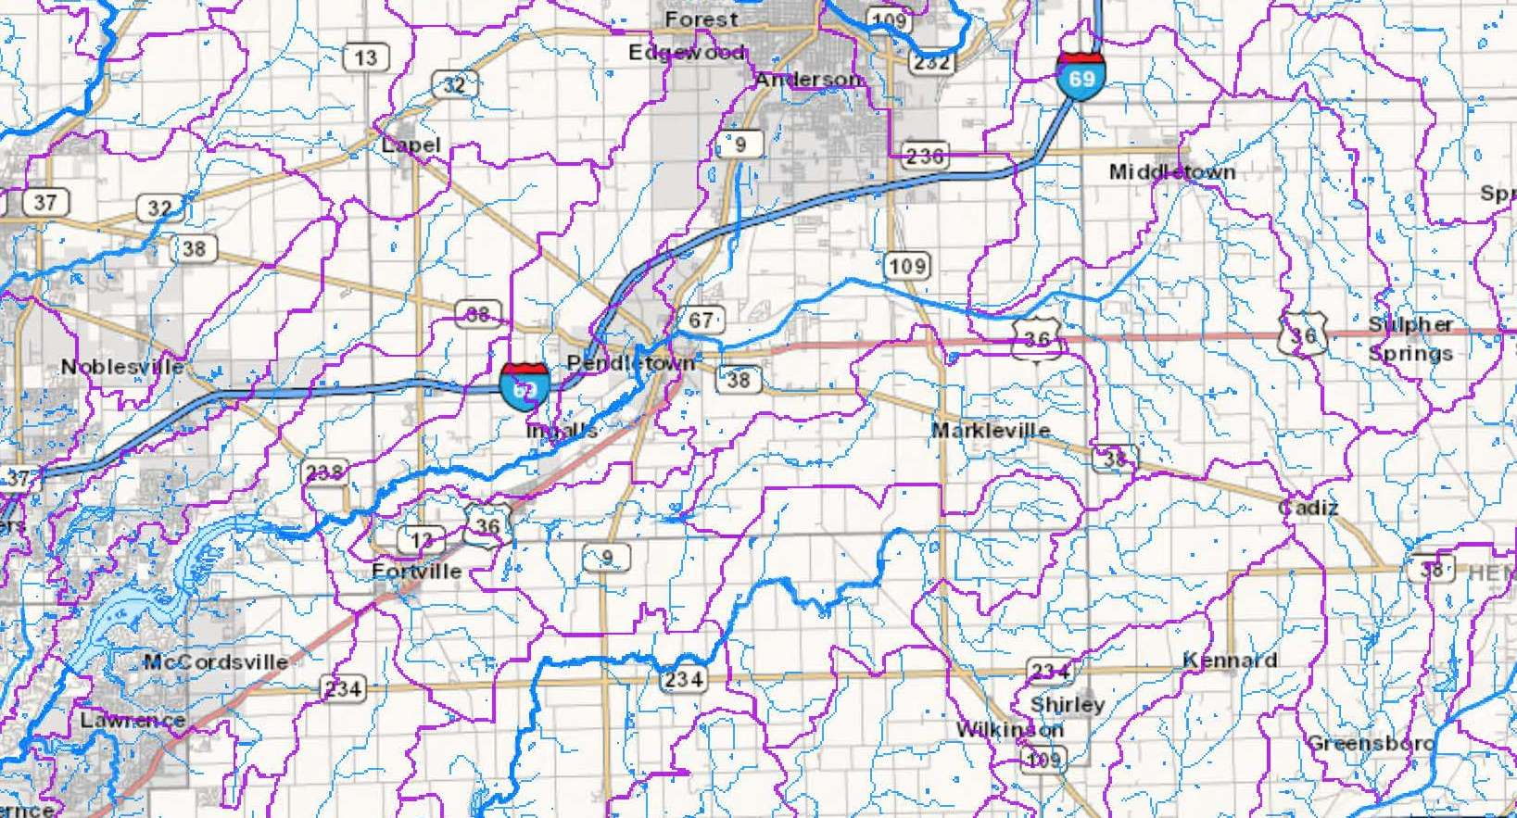
Geist Reservoir
Most have moderately sized watersheds (Group 2)
1:250,000

Slide 11
Geist Reservoir
Size relationship 1.0-2.0% (Geist = 1.3%)
1:250,000

Slide 12
Geist Reservoir
1 acre of water drains 75-100 acres of land
1:250,000

Slide 13
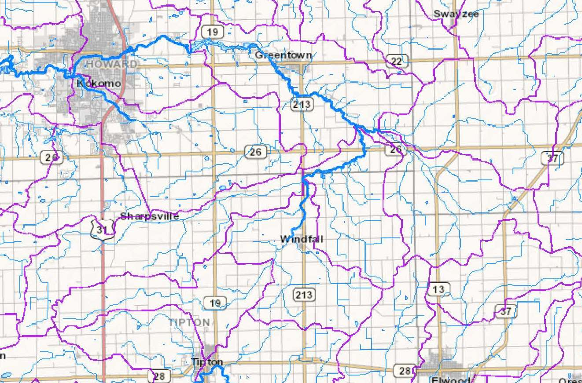
Kokomo #2
1:250,000

Slide 14
Kokomo #2
Few have rather large to ‘humongous’ watersheds draining into them (Group 3)
Size relationship = 0.5% or less
  0.42% Kokomo
1 acre of water drains 238 acres of land (Kokomo)
  Cedarville – 1 acre of water drains 2,000 acres
  Shafer & Freeman – 1 acre drains 10,000 acres
These are the hardest working bodies of water in Indiana

Slide 15
“Hard working”?
How well do they fulfill the purpose(s) for which they were built?
  Parameters might be ‘okay’ for hydroelectric use
  Or problematic for water storage use (storm or drinking), due to decreased storage volumes
  Or challenging for those with drinking water intakes

Slide 16
Map View
Group 1 (ratio >3.0%)
Group 2 (ratio 1.0-2.0%)
Group 3 (ratio < 0.5%)

Slide 17
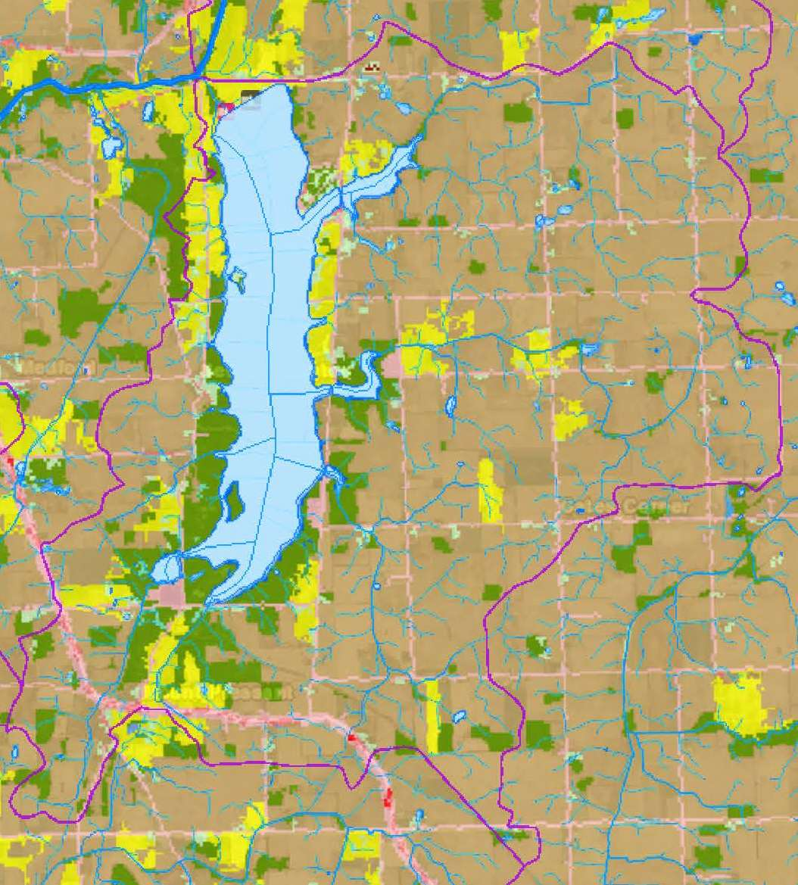
Prairie Creek
Row crops (brown) and pasture/hay (yellow)
Forested near lake (green)
Small amount development along county roads

Slide 18
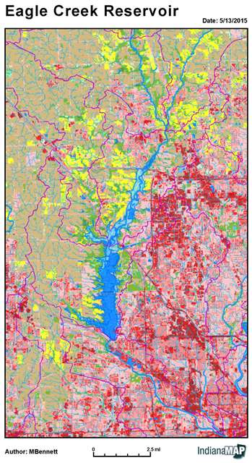
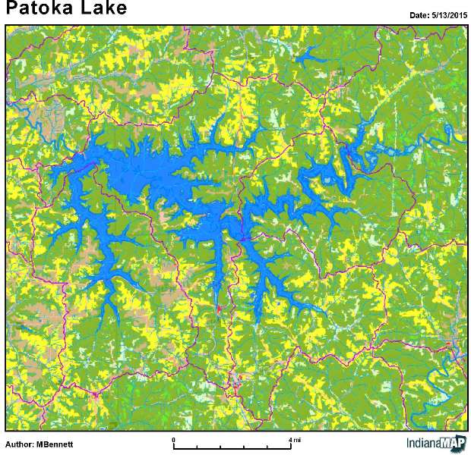
Highly developed shore vs. ag shore
Uniformly mixed woods and pastures with a scattering of row crops

Slide 19
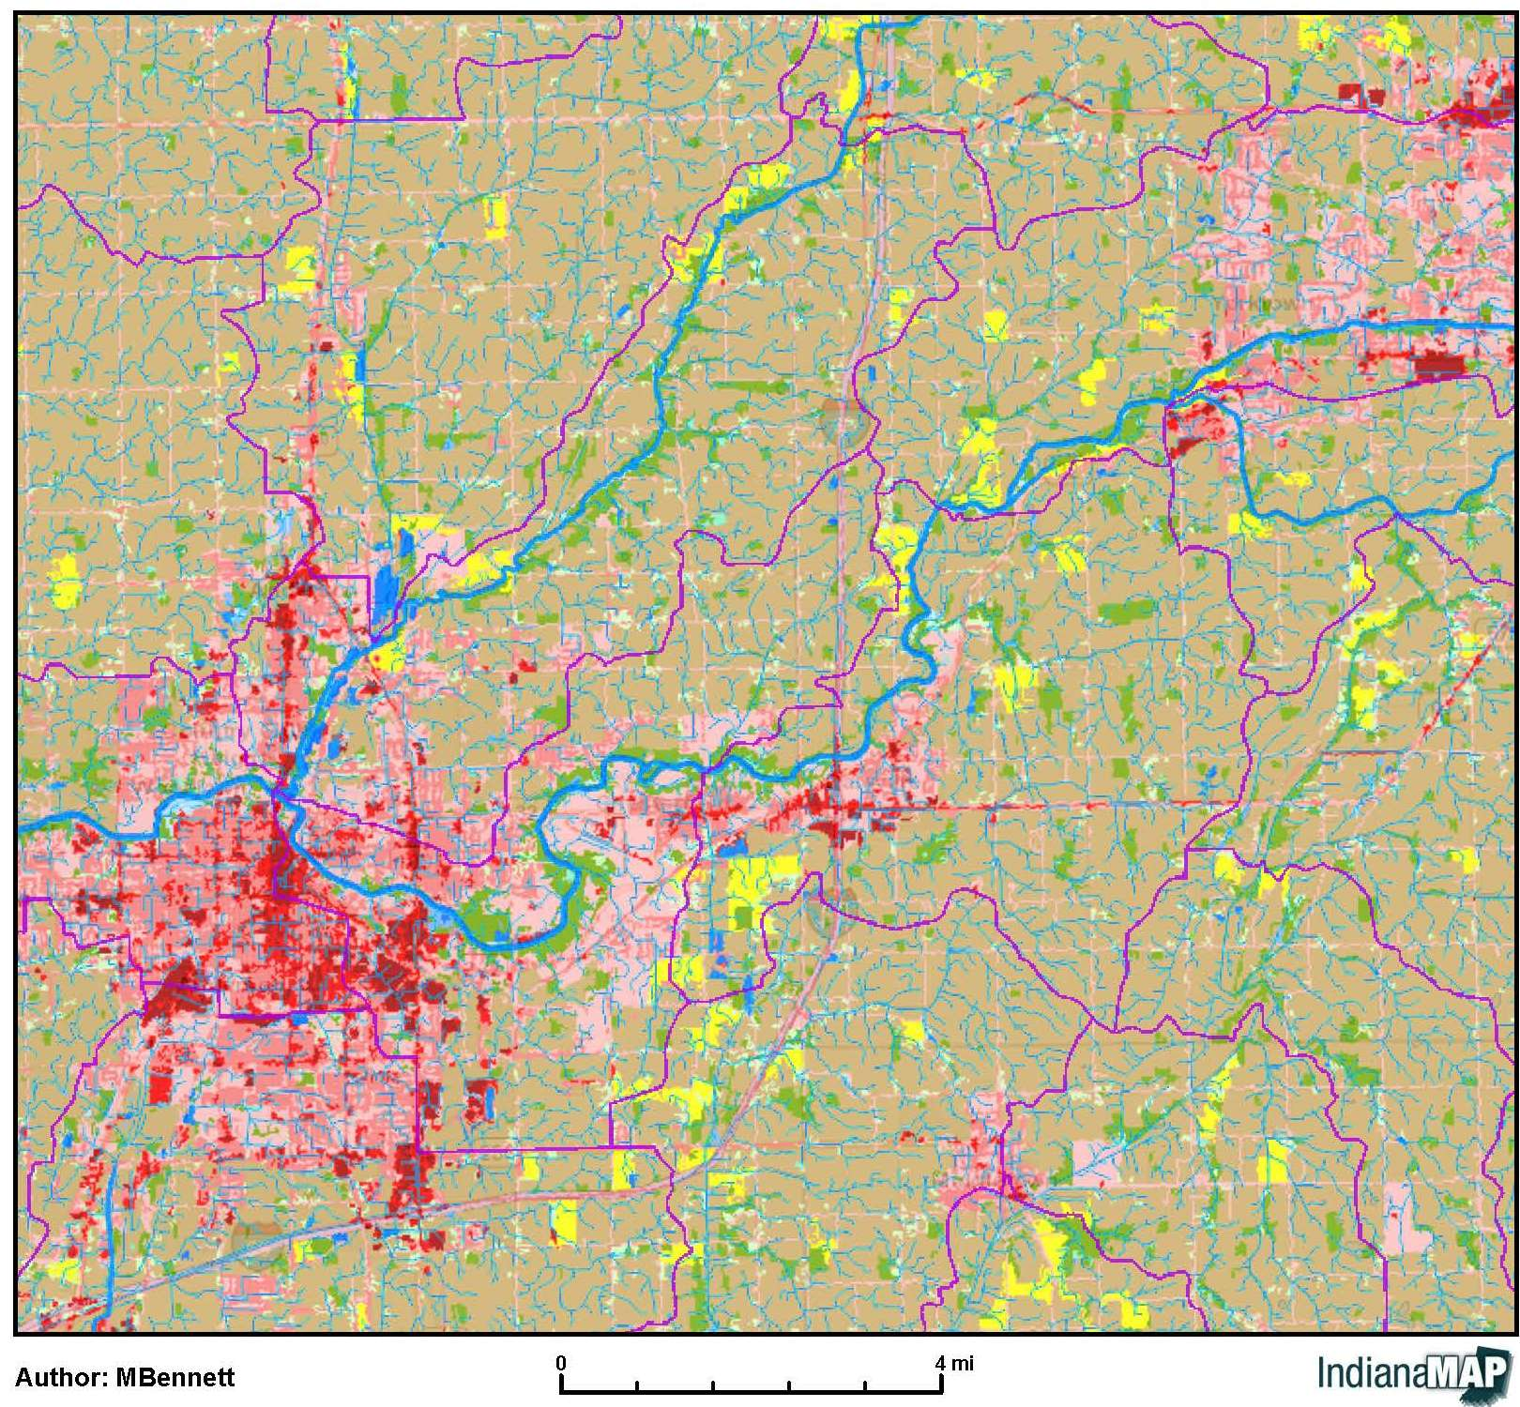
Proposed Mounds Reservoir in Madison County
Size =
2,100 acres
Drains
259,840 acres

Slide 20
Proposed Mounds Reservoir in Madison County
Lots of agricultural land
Plus urban / commercial / industrial use areas

Slide 21
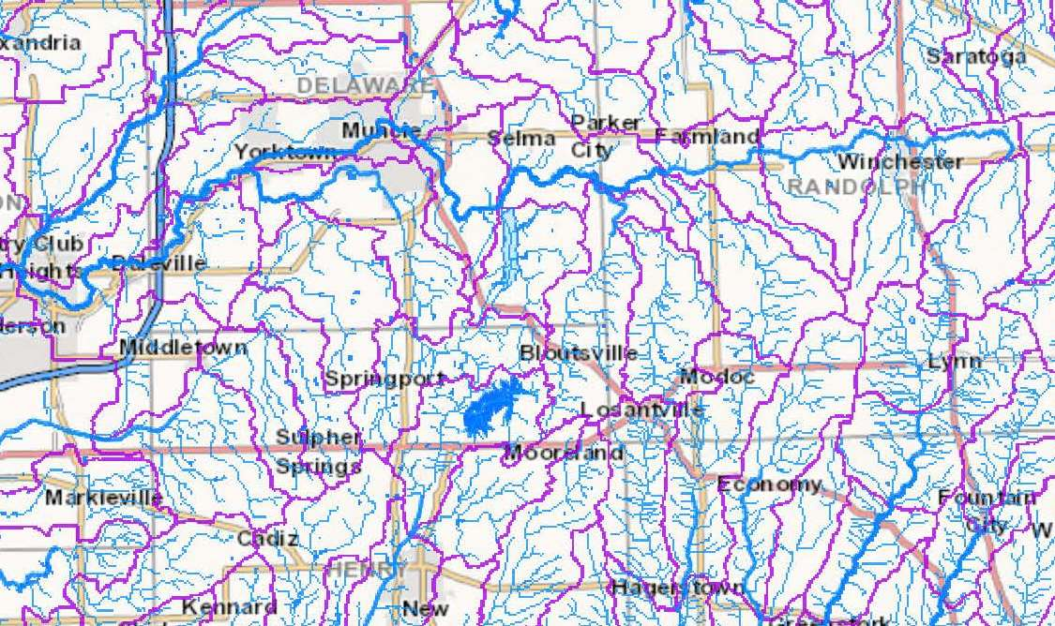
Proposed Mounds Reservoir
  Encompasses seventeen 12-digit HUCs (PC had 1)
Notes:
Important to consider land uses in all of those upstream Hydrologic Unit Code areas.
Also, important to consider that control of those areas is in the hands of other political jurisdictions and their land use, zoning and drainage policies and practices.

Slide 22


Third Step
Data gathering from off- and online sources
  IU/SPEA website (1988-2014)
  2014 List of Waterbody Impairments
  Historic files from IDEM
    Lake sediment and fish tissue sampling
    National Eutrophication Survey (EPA)
    Pertinent correspondence
    USGS and other reports
    Volunteer data

Slide 23
Trophic Information and Designated Use Support
Water Quality Indicators for Lake Lemon
Indicator | Value | Data Source | Last Updated
Area (Acres) | 1650 | * | 2008
Trophic Status | Eutrophic | * | 2008
Trophic Trend | Fluctuating | * | 2008
Support for Designated Uses
Recreational Use | Not Assessed | ** | 2008
Fishable Use | Impaired: 5B | ** | 2008
Aquatic Life Use | Not Assessed | ** | 2008
Total Number of Impairments | 1 | ** | 2008
Cause of Impairment(s), If Any | Mercury in Fish Tissue | *** | 2008

Slide 24
Data Crunching
  Comparing individual water quality parameters (collected to calculate Indiana Trophic State Index scores)
Secchi
PO4
Nitrogen
Plankton
DO

Slide 25
At First, Data Gaps
  Epilimnion and hypolimnion data unwieldy
  Water column averages easier and in keeping with other state lake assessments
  Historical data consulted for outliers and representativeness

Slide 26
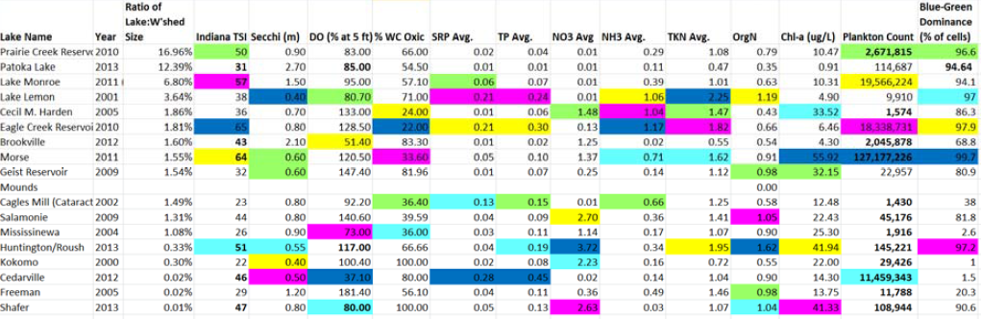
Still, CHAOS…

Slide 27
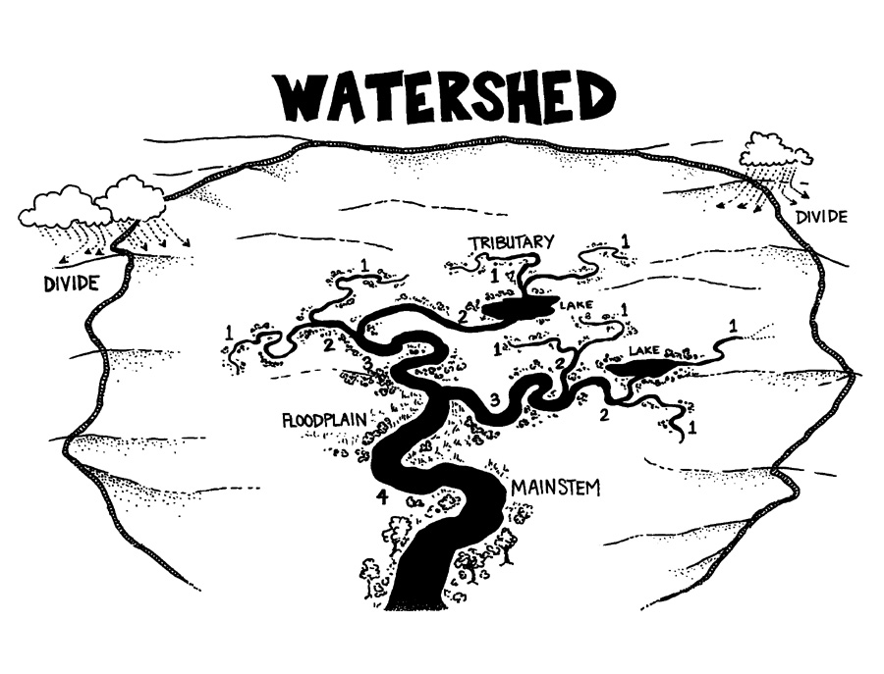
Waterbody to Watershed Ratio
  Area : Area
  Volume : Area
Adapted from Hoosier Riverwatch image

Slide 28
Reservoir Area : Watershed Area
  Resulted in multiple groups

Slide 29
Res. Volume : W’shed Area
  Fell nicely into three (3) groups (#2 >> Mounds group)

Slide 30
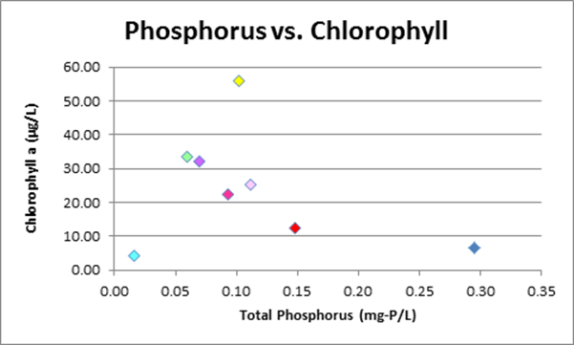
Pulling it All Together
  Cursory graphing to see which data appeared to be closely related…

Slide 31
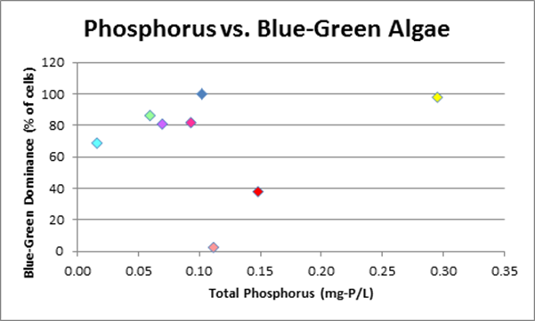
Pulling it All Together
  …or not so closely related

Slide 32
Pulling it All Together
  Compared average values by parameter

Slide 33
  Brookville appears as outlier here, due to lake not being stratified. Apparently lower gate was open causing mixed water column throughout.

Slide 38
Pulling it All Together
  Determined which parameters showed significant difference between three groups

Slide 39
Pulling it All Together
  Determined which ones correlated to water quality

Slide 40
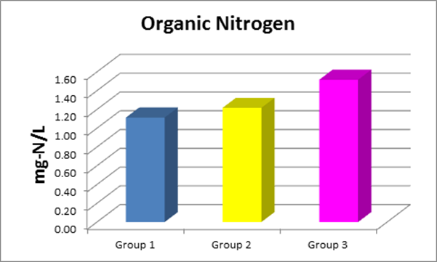
Notes:
Group 2 is where Mounds Reservoir will fall, if built as proposed.

Slide 41
Notes:
Keep in mind that Group 2…(next slide)

Slide 42
Notes:
(cont’d) … is where Mounds Reservoir will fall, based on watershed to lake ratio.

Slide 43
Lessons Learned
Working with water data as a whole
There is a lot of data available, but it is scattered and not all is available online
Improvements in lake trophic scores following Indiana’s ban on phosphates have maintained themselves
Drawing water from different lake depths effects DO and stratification
Watershed size : waterbody volume ratio’s effect on water quality was supported by Indiana’s reservoir data despite the significant differences in land use and topography across Indiana’s reservoirs

Slide 44
More Lessons Learned
Importance of erosion control
Need for nutrient
Sewers are better than septic tanks
Use of various forms of technology (hard and soft)
Murphy says “the greater your need for particular software package is, the more likely it will be taken offline for maintenance or upgrades”
Working as a team!!!

Slide 45
What’s Next?
Comparing additional impoundments which have similar size ratios to see if they respond the same
More complete assessment of land use types and impervious surfaces (running various models)
Running better statistics on groups and parameters to verify significant differences
Further data analysis to determine anomalies vs. general variability
Create online guidance document for public use

Slide 46
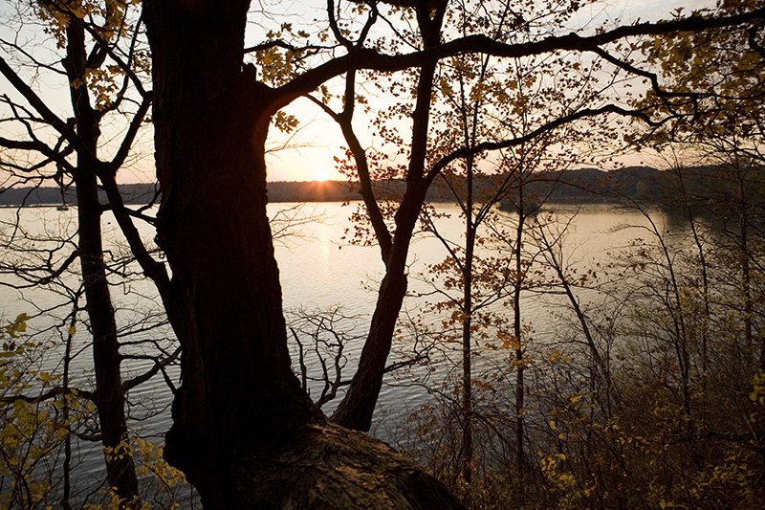
Thank You!

